Slide 1
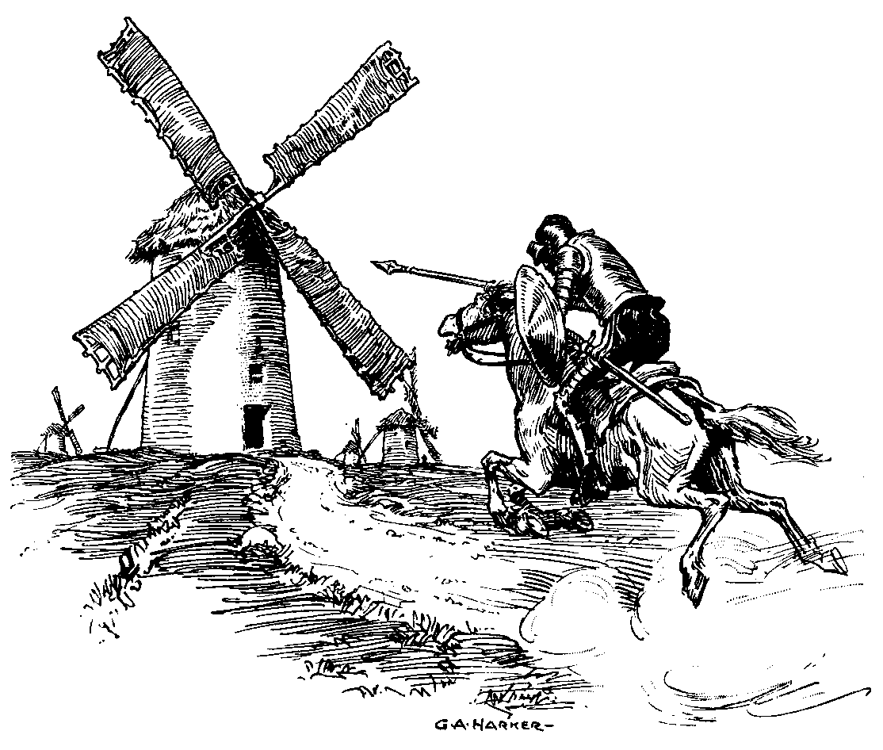
Beyond the Pale: grey literature as a method of publication

Slide 2
Introduction
A (very) quick overview of grey literature
Case studies in archaeological publication
The potential of an Open Access approach
A mix of my own PhD research
Ongoing projects at the ADS:
  OASIS and the Rural Settlement of Roman Britain
Note: based on data from England

Slide 3
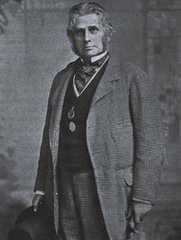
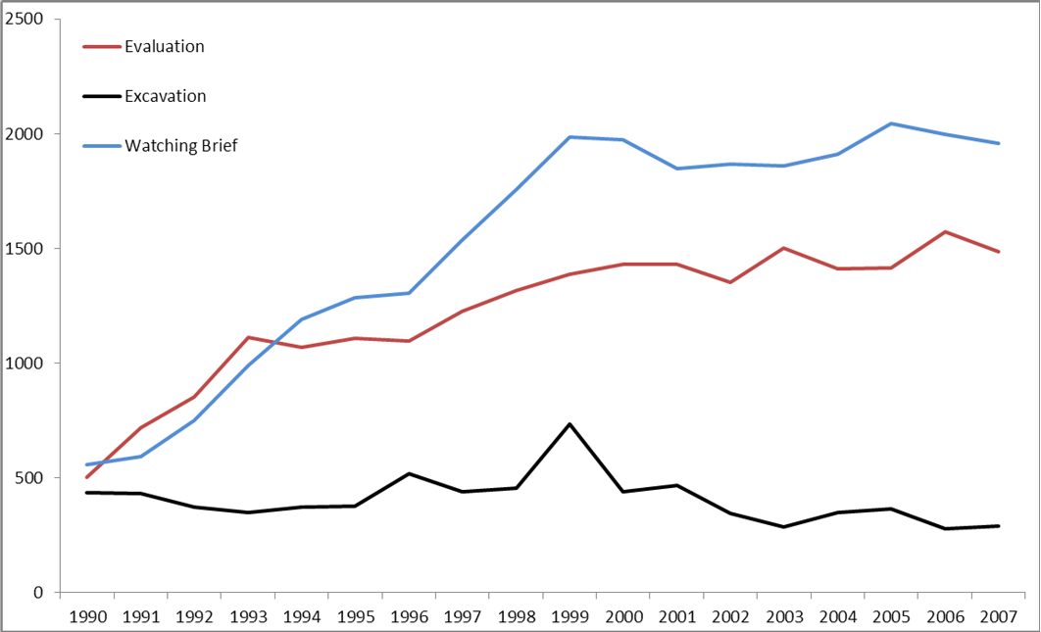
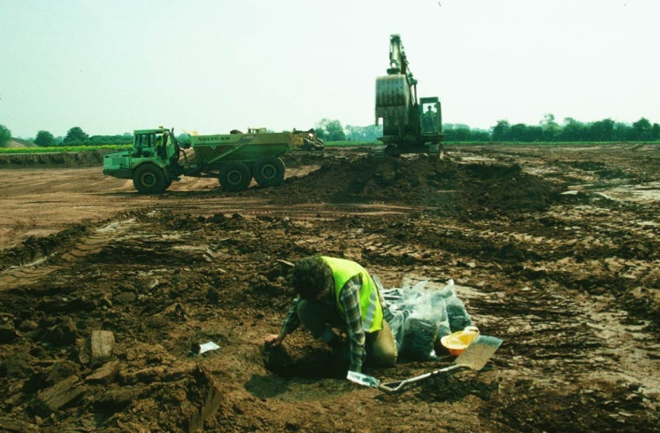
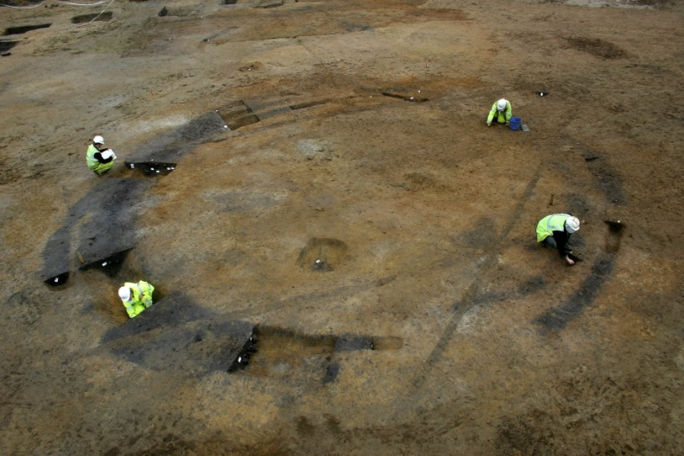
Rise in work
Data from the Historic England Excavation Index
http://archaeologydataservice.ac.uk/archives/view/304/
Notes:
Slide explaining the rise in works

Slide 4
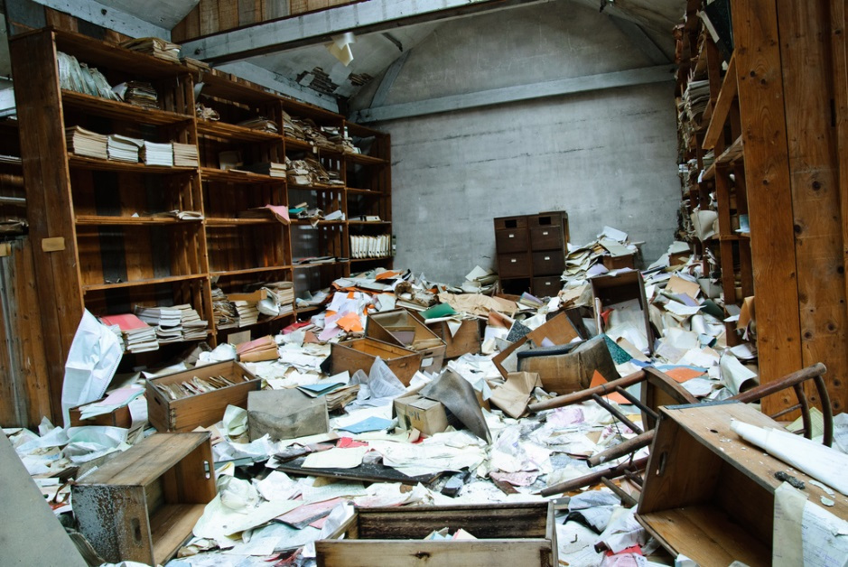
Publication crisis

Slide 5
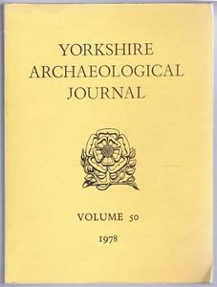
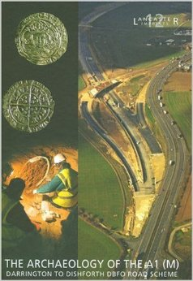
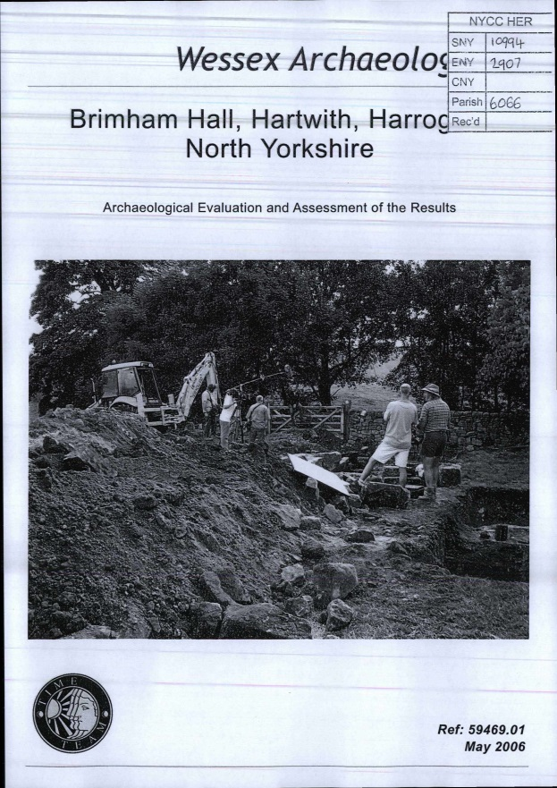
Change over time

Slide 6
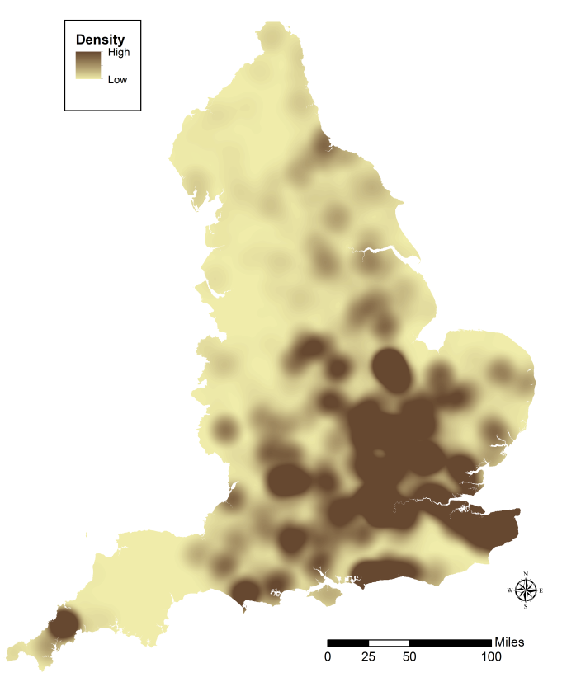
Consequences/current thought
Currently in an age of advanced data re-use.
Post-PPG16: Drowning in Data?
Unknown unknowns
PPG16 investigations used by the Prehistory of Britain and Ireland project
[Data from doi:10.5284/1028304]
Notes:
Bradley, Fulford etc etc

Slide 7
Attitudes to ‘grey literature’
A problem (for academics at least)
  Inaccessible
    Available in hard-copy only
  Poor quality
    Lack of interpretation
    Lack of information (plans)

Slide 8

Attitudes to ‘grey literature’
“…stands for manifold document types produced on all levels of government, academics, business and industry in print and electronic formats that are protected by intellectual property rights, of sufficient quality to be collected and preserved by library holdings or institutional repositories, but not controlled by commercial publishers i.e., where publishing is not the primary activity of the producing body”

Slide 9
Questions
How much grey literature is there relative to traditional published material (and wholly unpublished works)?
Why does it exist?
Is it all bad?

Slide 10
Case studies
North Yorkshire
Staffordshire

Slide 11
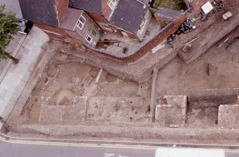
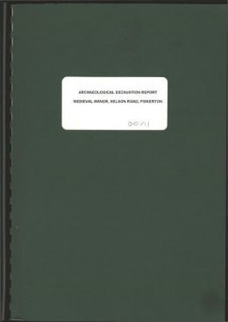

Definitive record of excavations + outputs
Excavation
Output
Quality

Slide 12
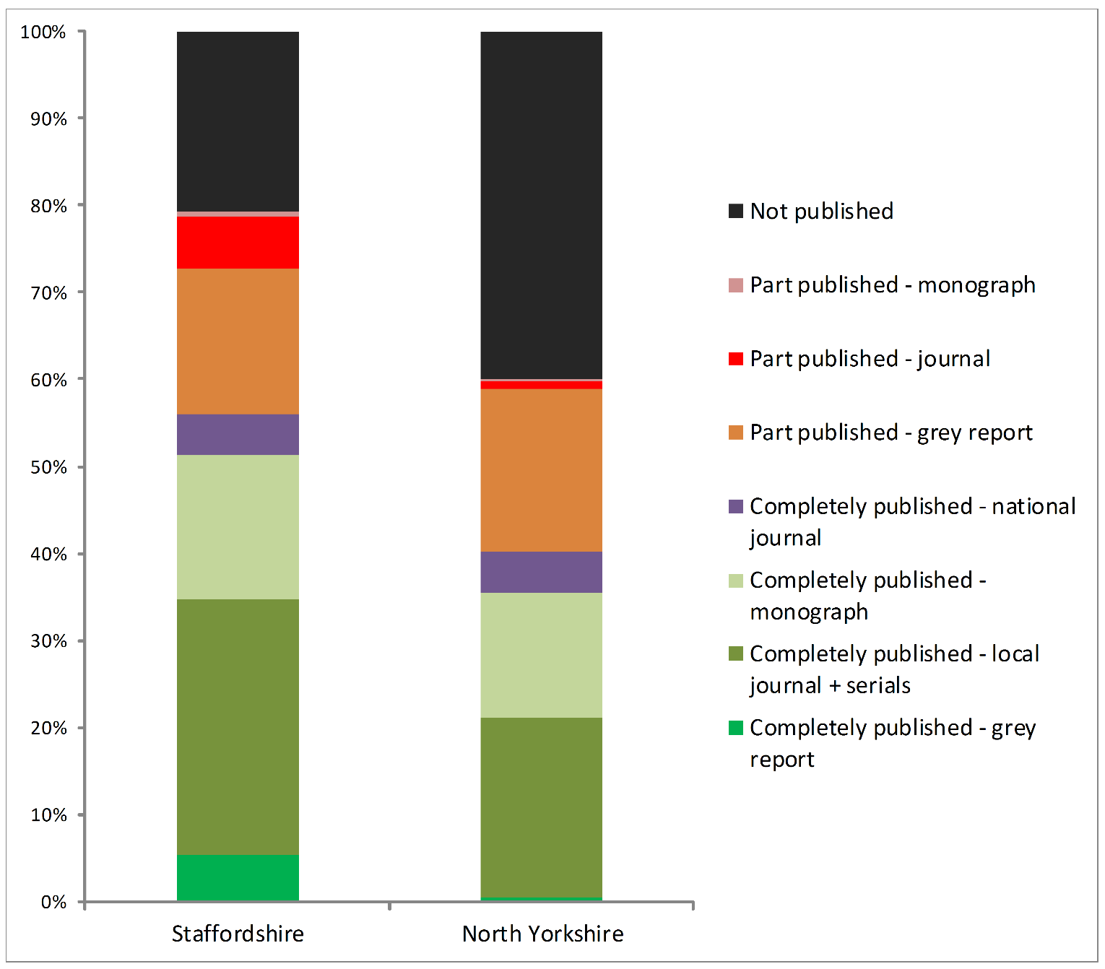
What’s published?

Slide 13
Fate of planning-led events
Just excavations of regional or national significance
All recorded events

Slide 14
Why is there so much grey literature
Evaluations very rarely have recourse to further publication
Smaller excavations are often deemed to be adequately served by a (grey) report only
Personal/organisational – mistakes, disaster etc
Local curators can have difficulties in enforcing post-excavation recommendations
Money (or lack of)!
Not accepted by local journals

Slide 15
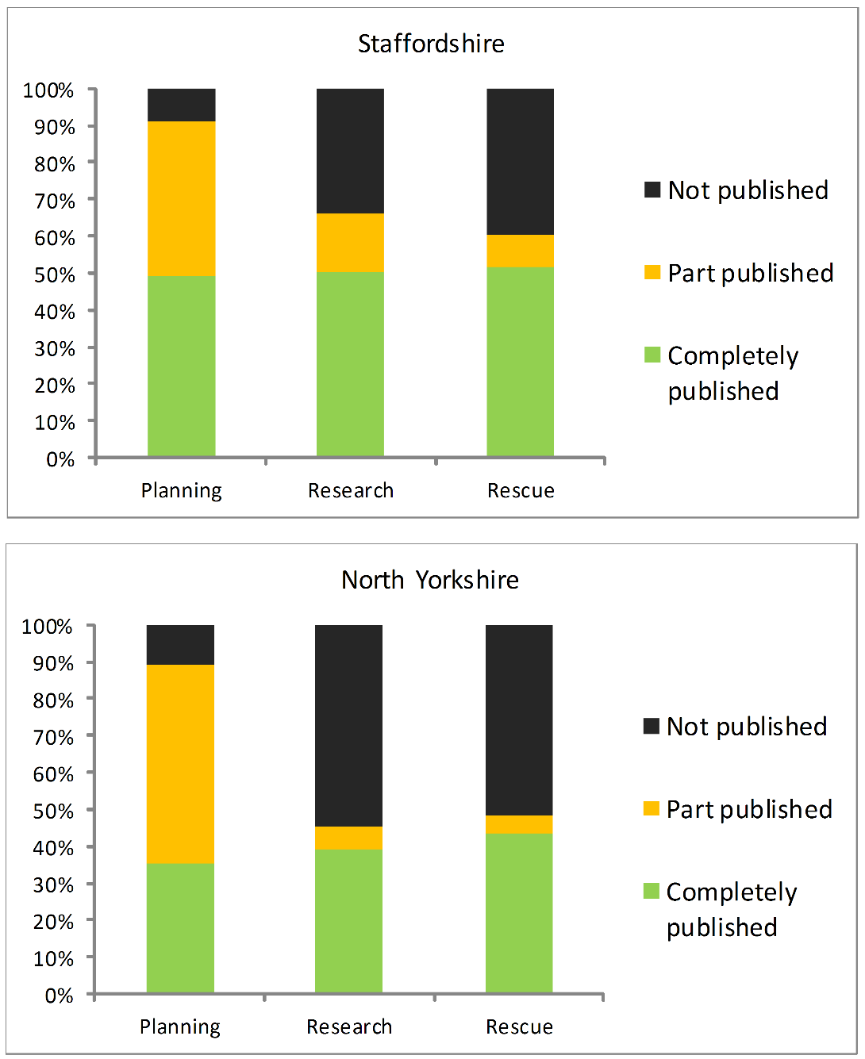
Is it a bad thing?
Represents an increase
in works reaching some
form of written output

Slide 16
Content of ‘grey literature’
Staffordshire

Slide 17
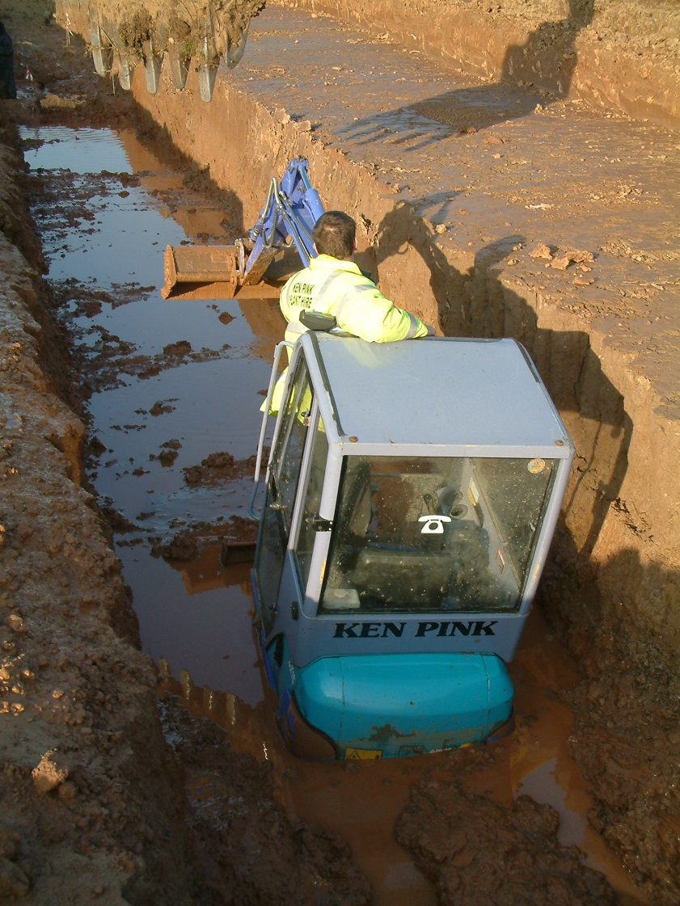
Thoughts
Is it even possible to publish everything in the traditional manner?
Should we refine what it is to be published?
Publication by wider synthesis rather than at a site-level?
Increased (and pragmatic) emphasis on grey literature (including stop calling it that!)

Slide 18
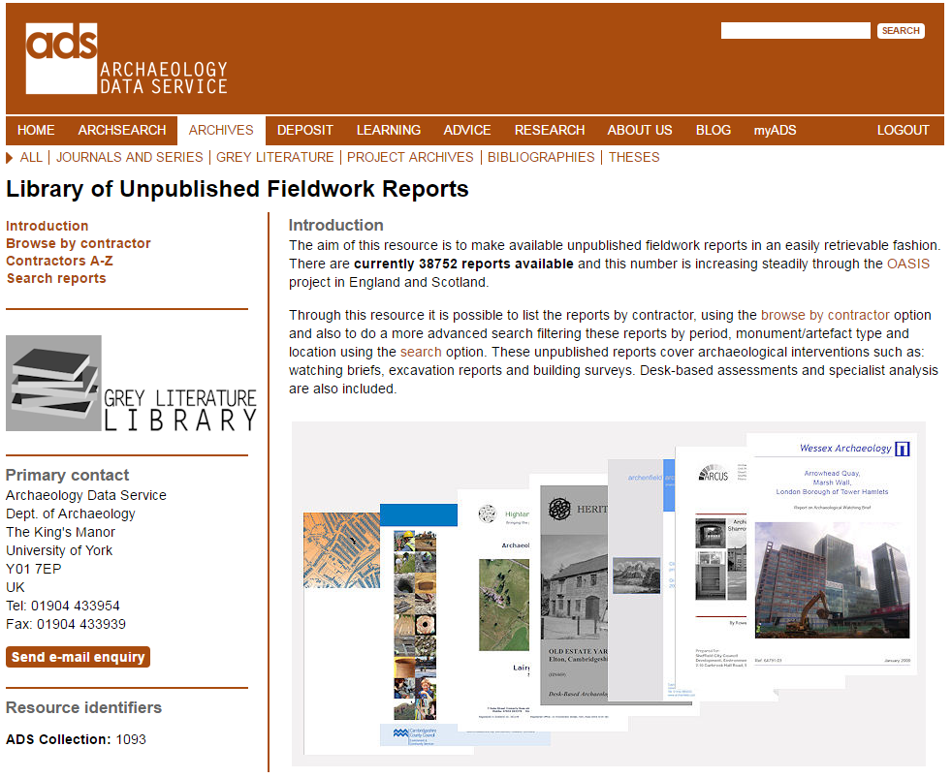
Open Access

Slide 19
OASIS
Reports released into ADS library via OASIS (England)

Slide 20
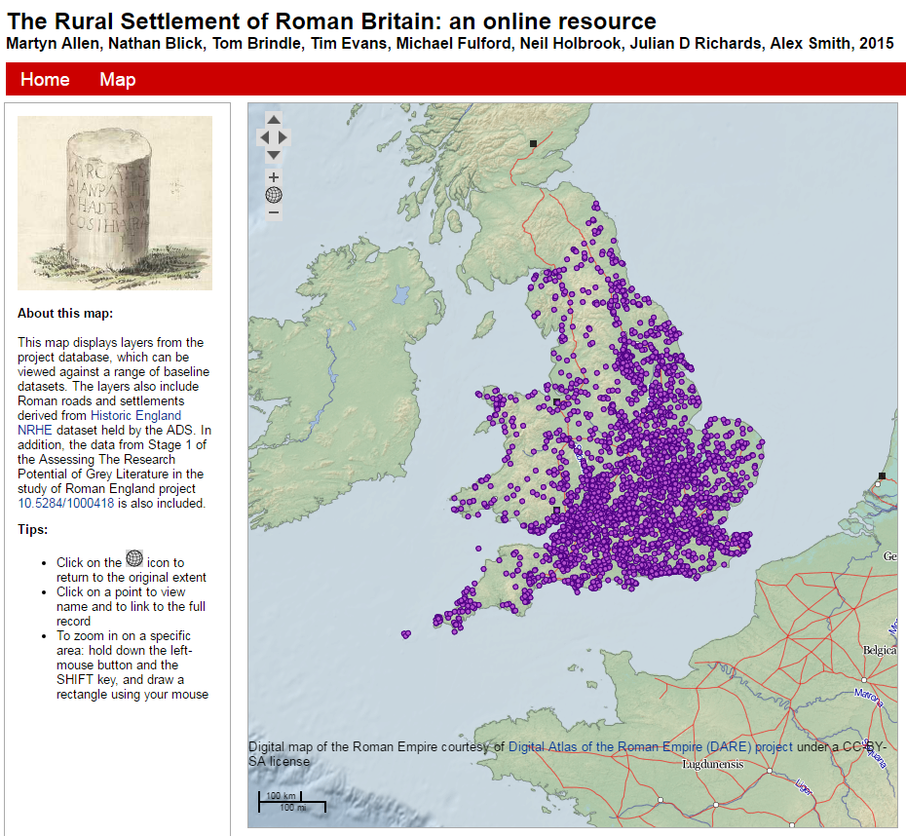




In academic practice
doi:10.5284/1030449

Slide 21
In academic practice
3479 records from England (1800s to 2014!)
1630 records with GL
1375 records with only GL
  1477 reports
  337 reports from OASIS (22%)

Slide 22
In academic practice

Slide 23
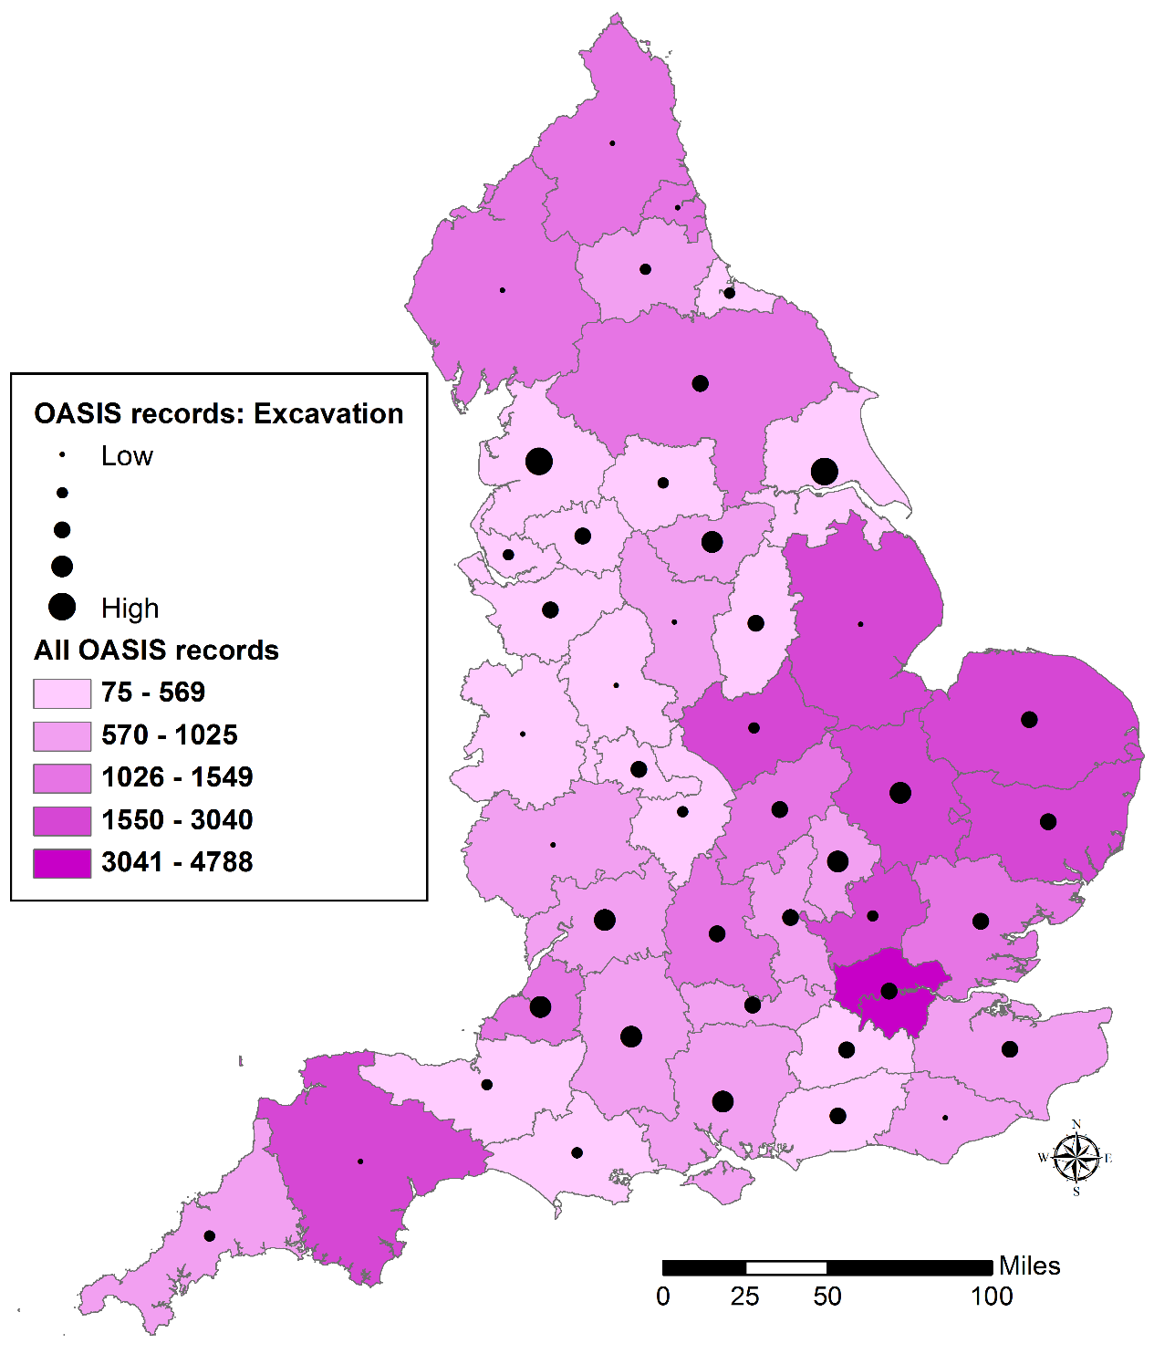
http://archaeologydataservice.ac.uk/blog/oasis/

Slide 24
Final thoughts
A pragmatic approach: grey literature can be a good thing
The tip of the iceberg – what about the data behind the reports?

