Slide 1
Archiving and Repositories
Holly Wright

Slide 2
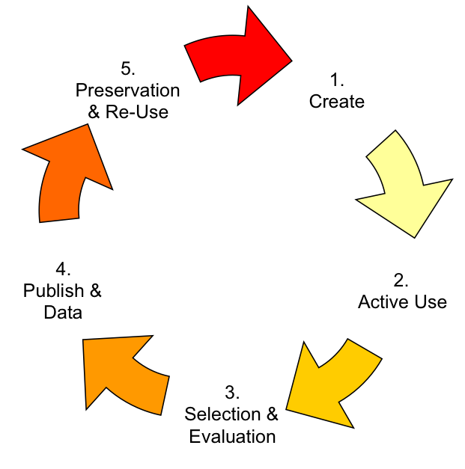
Data archiving in the digital lifecycle
Where data archiving fits
At the start of the project - identifying the archive or repository to be used
Before starting data capture – check archive requirements
During the project – documentation + deposit
On completion – deposit
After the project – enabling access and reuse

Slide 3

Overview
Why Deposit?
1. Ensure Preservation
2. Provide Access
3. Professional Recognition
4. Follow Professional Standards
5. Meet Governmental Requirements
6. Meet Funding Agency Requirements

Slide 4

Overview
Data Deposit Requirements
AHRC
Submission of a ‘Technical plan’
replaces the Technical Appendix as of 2012
is essential:
  “where digital outputs or digital technologies are an essential part to the planned research outcomes”.
  This should give a summary of those outputs, explain the technical methodology, technical support / experience, and address preservation, sustainability and use.

Slide 5
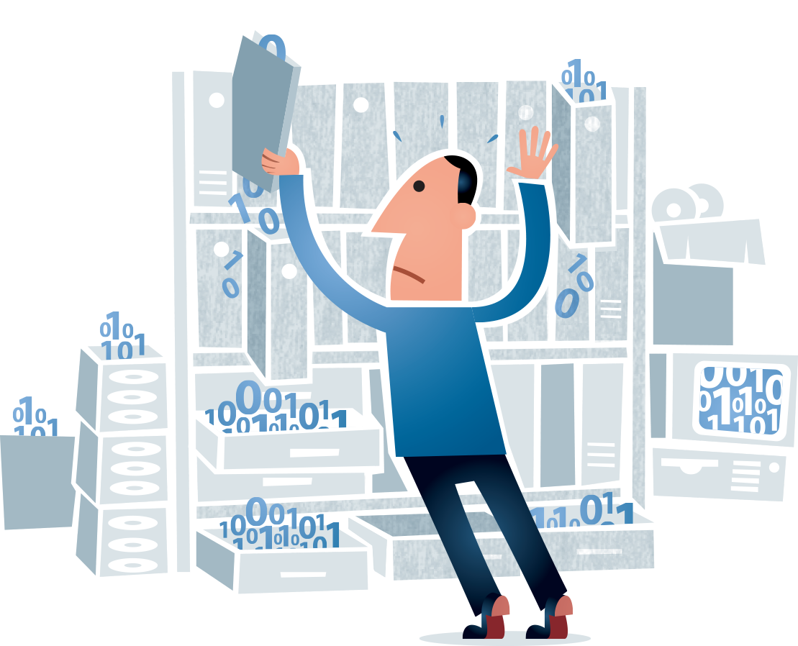
Archiving
What happens to data once its deposited?
Image © www.digitalbevaring.dk

Slide 6
Archiving
Behind the Scenes at the ADS
Follow the Open Archival Information System (OAIS) reference model
  International ISO standard 14721
Ensure the multiple and regular backups and the renewal of storage media
  Virtual Server
  Tape backup at University of York & Hull
  Deep Store
  Five year rotation strategy
Use data migration strategies

Slide 7
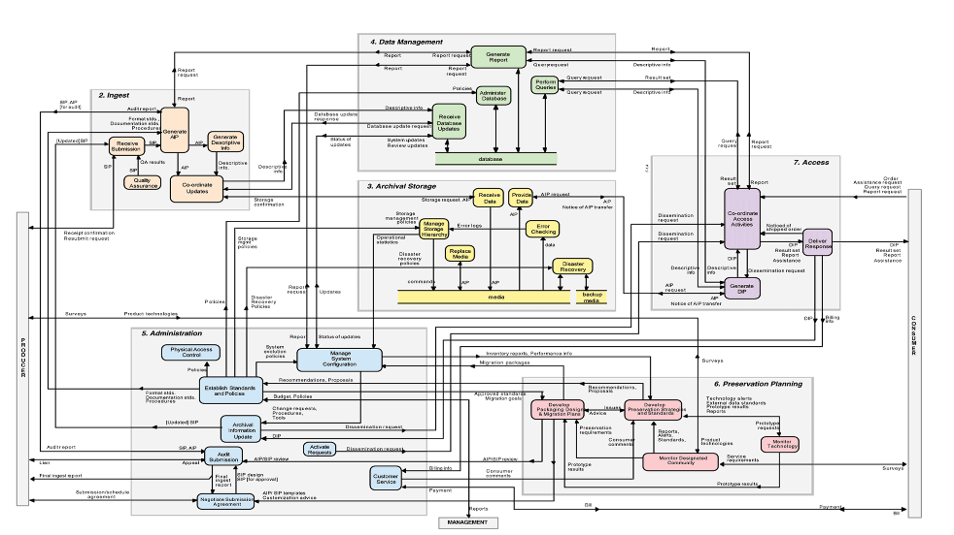
Archiving

Slide 8
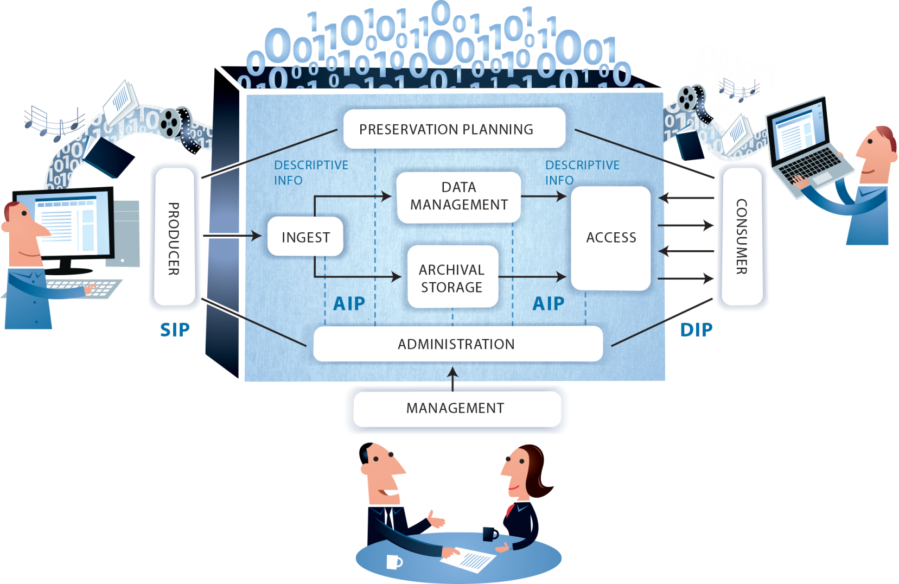
Archiving
Open Archival Information System (OAIS) reference model
Image © www.digitalbevaring.dk

Slide 9
Archiving
Open Archival Information System (OAIS) reference model
Image © www.digitalbevaring.dk

Slide 10
Archiving
Deposit Evaluation
Intellectual content & potential interest in their re-use
Viability of data: management, preservation and dissemination
Are we a suitable archive?
Authority to deposit the data
Material is ‘complete’
Digital form in preferred file format – consult repository websites
Sufficient project documentation and file Metadata

Slide 11
Archiving
Image © www.digitalbevaring.dk

Slide 12

Archiving
Submission Information Package (SIP)
Virus check
Media and file readability check
Data resource integrity check
Check file formats suitable for deposit
Documentation completeness check
Data validation and consistency checks
Web interface text check
Copy to data server
© Digital Preservation Business Case Toolkit

Slide 13
Archiving
Submission Information Package (SIP)
Authenticate original version
Replace spaces with underscores
Log details of SIP in Collections Management System
Create checksums
Run Droid to generate file level metadata
Store licence
Scan paper documentation
Acknowledge receipt of data
Store original media
© Digital Preservation Business Case Toolkit

Slide 14
Archiving
Image © www.digitalbevaring.dk

Slide 15
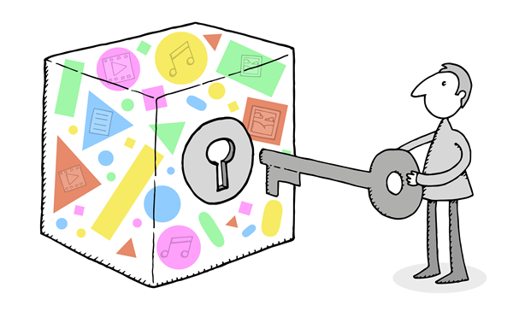
Archiving
Archival Information Package (AIP)
Check licence
Check copyright and confidentiality clearance
Consistency checks
Selecting preservation and dissemination file formats
Develop a conversion plan
Convert the files
Validate file conversion
Metadata update
Create and store checksums for the AIP
Submit AIP for checking
© Digital Preservation Business Case Toolkit

Slide 16
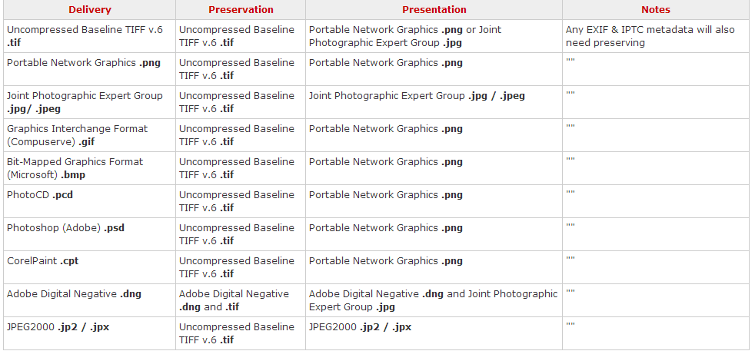
Archiving
Information Packages

Slide 17
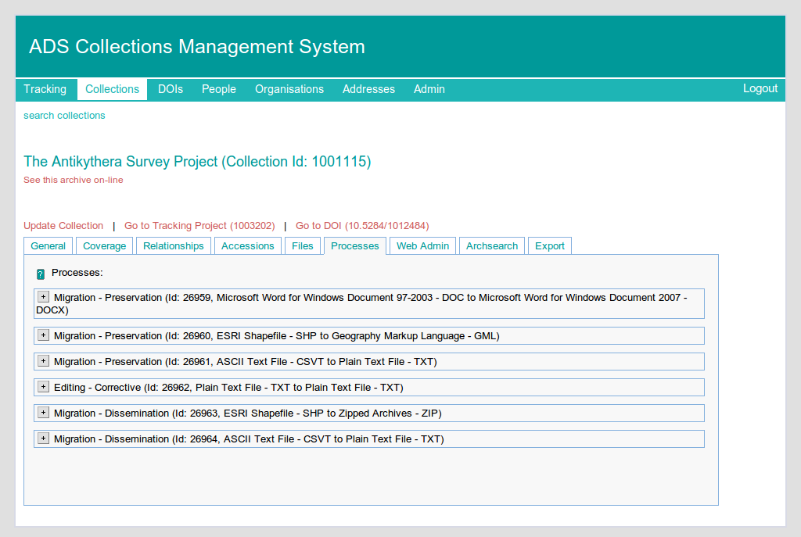
Archiving
Migration
Requires active and continuous
management

Slide 18
Archiving
Image © www.digitalbevaring.dk

Slide 19

Archiving
Dissemination Information Package (DIP)
Convert the files
Validate file conversion
Create web interface
Allocate permanent urls / DOIs
Pre-Release interface
Make any depositor changes
Release Archive
Publicise Archive
Image © www.digitalbevaring.dk

Slide 20
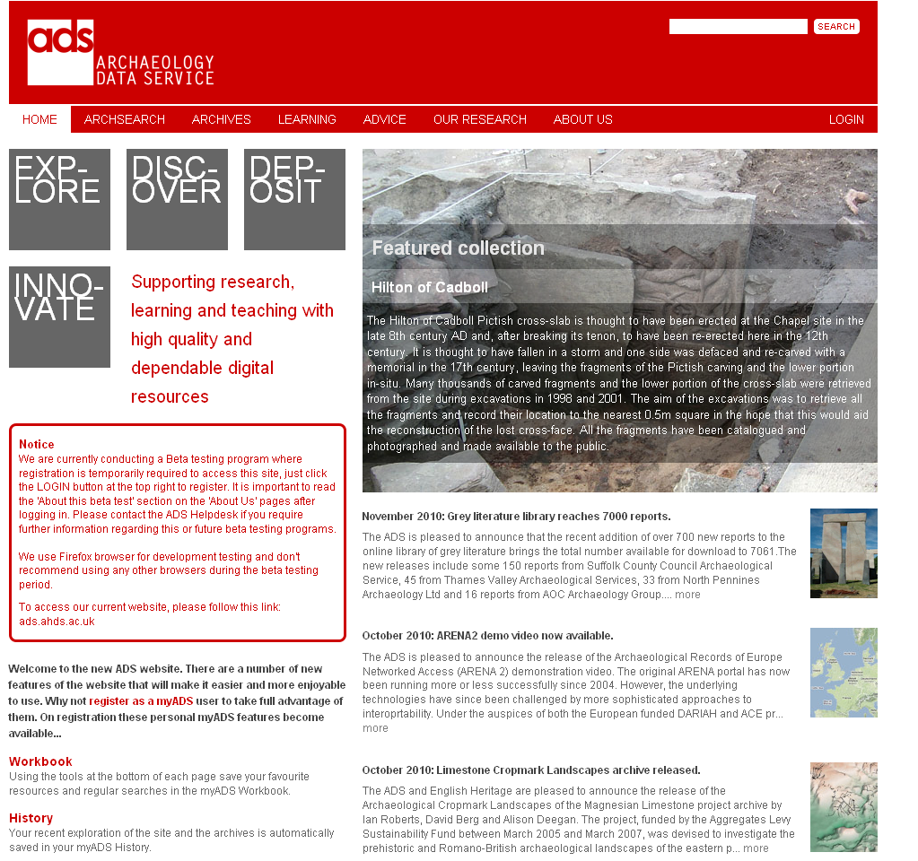
Dissemination
How do ADS disseminate data?
All archives are freely available
through the web interface.
http://archaeologydataservice.ac.uk/

Slide 21
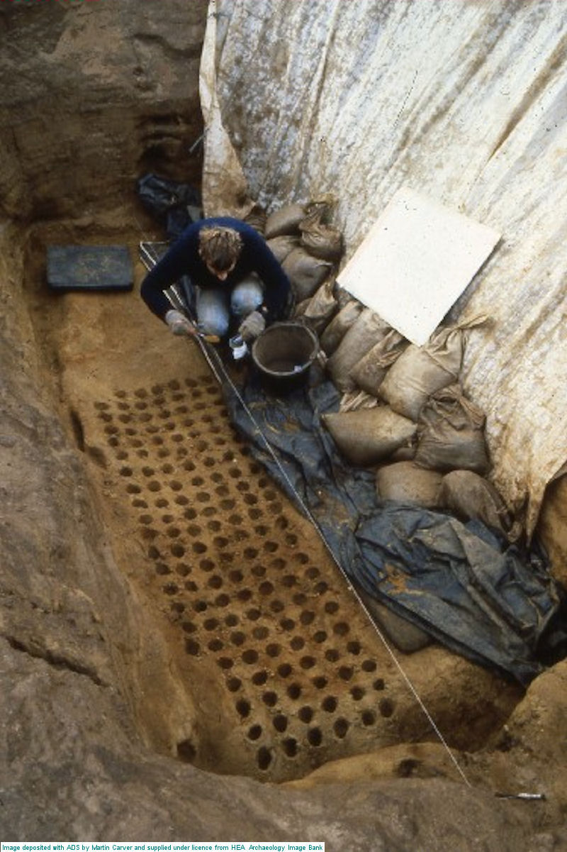
Dissemination
ADS Resources
1.3 million metadata records
Archives
22 Journals and Series
35,000+ Grey Literature reports
900+ Project Archives
Six specialist Bibliographies
19 Doctoral Theses
Specialised Websites
England’s Rock Art
Image Bank

Slide 22
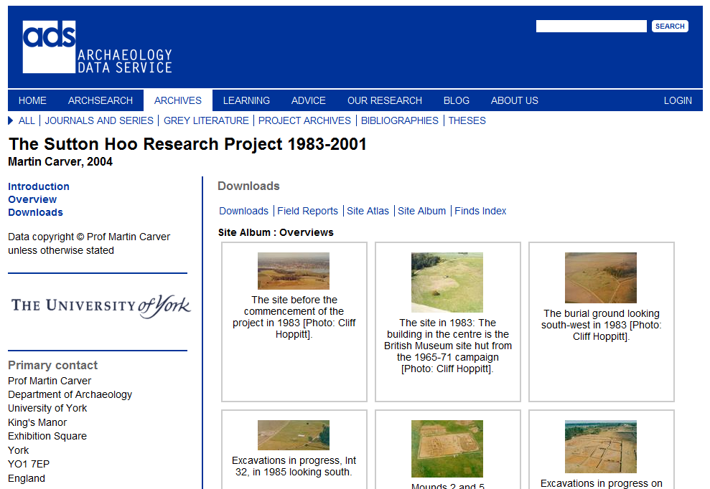
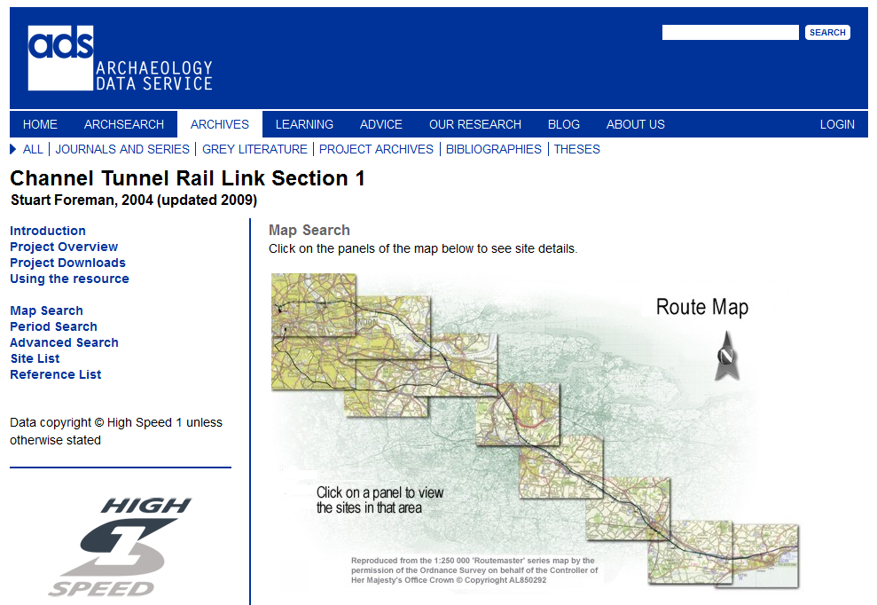
Dissemination
Project Archives
University-led research projects
Major infrastructure programmes

Slide 23
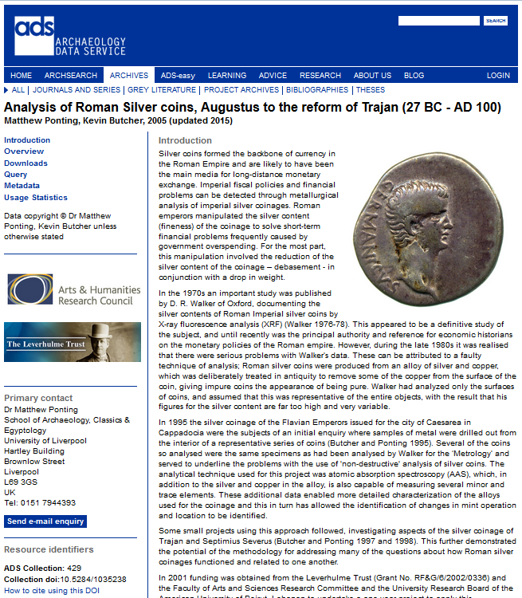
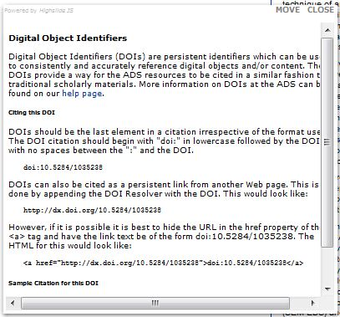
Dissemination
Project Archives
Introduction
Overview
Downloads and/or Search
Metadata
Usage Statistics
Resource Identifiers

Slide 24


Acknowledgements
ARIADNE is a project funded by the European Commission under the Community’s Seventh Framework Programme, contract no. FP7-INFRASTRUCTURES-2012-1-313193.
These training materials are based on teaching materials for research data management in archaeology created by Lindsay Lloyd Smith (2011) in the JISC-funded DataTrain project based at Cambridge University Library with contributions from the Archaeology Data Service.

